Slide 1


Academic Performance Through the Lens of Socio-Demographic Data
Statistics for Data Analysts - Final Presentation
Members:
Amit Ashok Manjarly (1233931935)
Chetan Jitendra (1233602398)
Isha Kaushik (1233665929)
Kushal Keshav Ravipati (1234047167)

Slide 2


Introduction
This project investigates how socio-demographic and educational support factors affect student performance in Math, Reading, and Writing.
Dataset includes exam scores and background factors like gender, parental education, lunch type, and test preparation.

Slide 3
Objective
Identify
Identify key factors influencing academic performance.
Evaluate
Evaluate the significance of gender, economic background, test prep, and parental education.
Build
Build a predictive model using regression analysis.

Slide 4
Dataset Overview
Size: 1,000 student records.
Features
Scores: Math, Reading, Writing
Demographics: Gender, Race/Ethnicity, Parental Education
External: Lunch type, Test Preparation Course
No missing values; some categorical imbalance was handled via encoding.

Slide 5
Exploratory Data Analysis
Average Scores: Math: 66.1, Reading: 69.2, Writing: 68.1
Insights:
Reading and Writing are strongly correlated.
Most students are female and from Group C.
64.2% did not complete test prep; 64.5% received standard lunch.

Slide 6
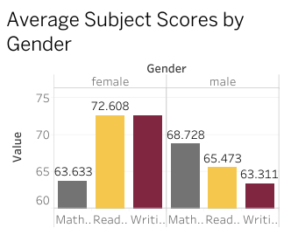
Key Visual Trends
Female students scored higher in Reading and Writing.
Males did slightly better in Math.

Slide 7
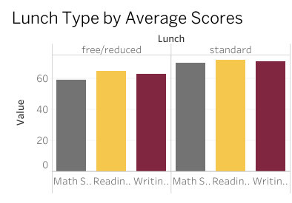
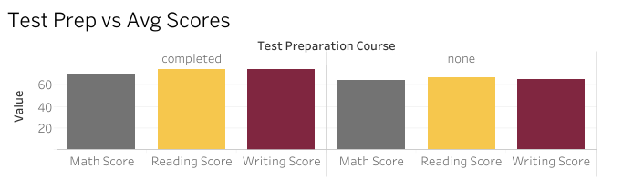
Standard lunch students scored significantly higher across all subjects.
Completing a test prep course correlates with better scores.

Slide 8
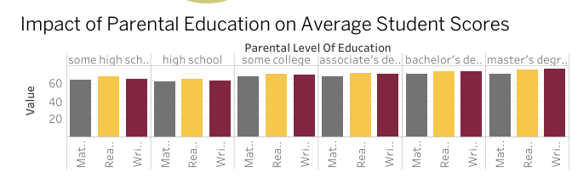
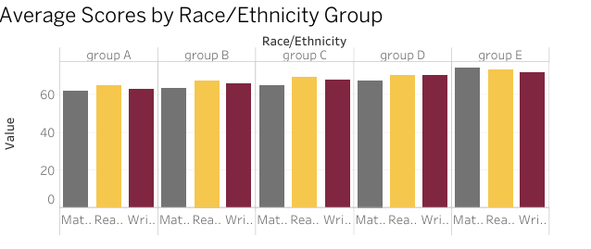
Scores improve with higher parental education, especially at bachelor’s and master’s levels.
Slight variations; Groups D and E performed relatively well

Slide 9
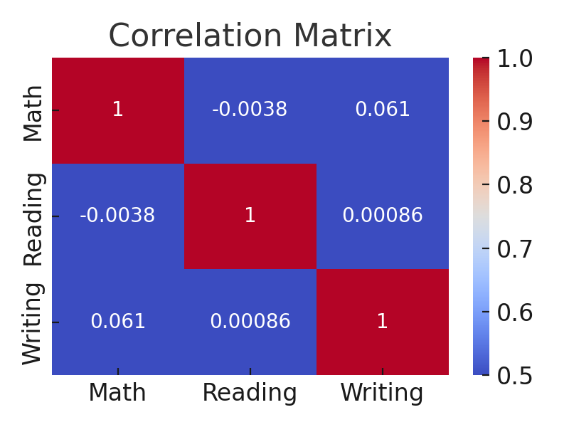
Summary of Hypotheses-Based Insights
Gender affects math performance slightly; females excel in Reading/Writing.
Economic background (lunch type) has a major impact on scores.
Test prep completion leads to higher academic performance.
Parental education shows an upward performance trend.
No strong relationship between gender and test prep participation.

Slide 10
Conclusion
Gender, economic status, and test prep participation influence academic performance.
Parental education has intuitive but not statistically significant effects.
Schools should focus on providing academic support and reducing disparities.

Slide 11

Recommendations
1
2
3
4
Promote test preparation programs.
Provide additional resources to students on free/reduced lunch.
Use data to customize learning interventions.
Encourage parental involvement regardless of education level.

Slide 12
Thank You!

